Slide 1
Parking Vacancies Detection
Athens University of Economics & Business

Slide 2
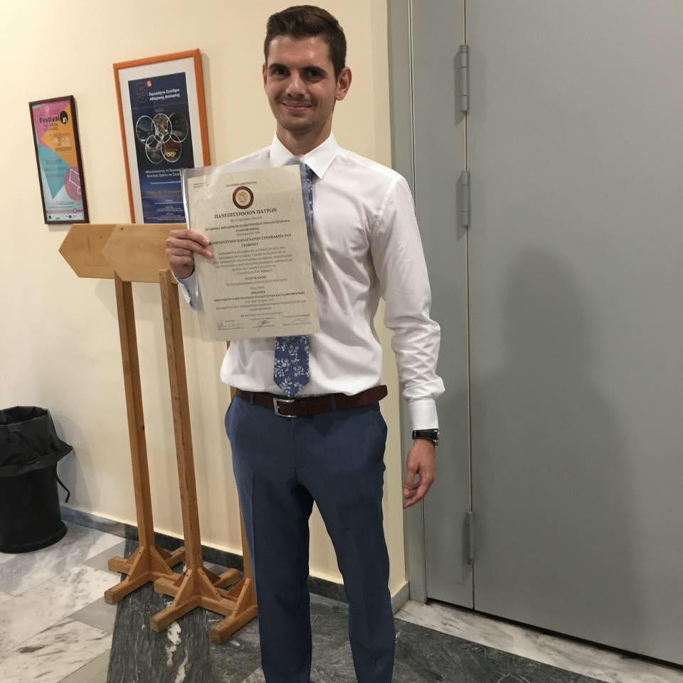
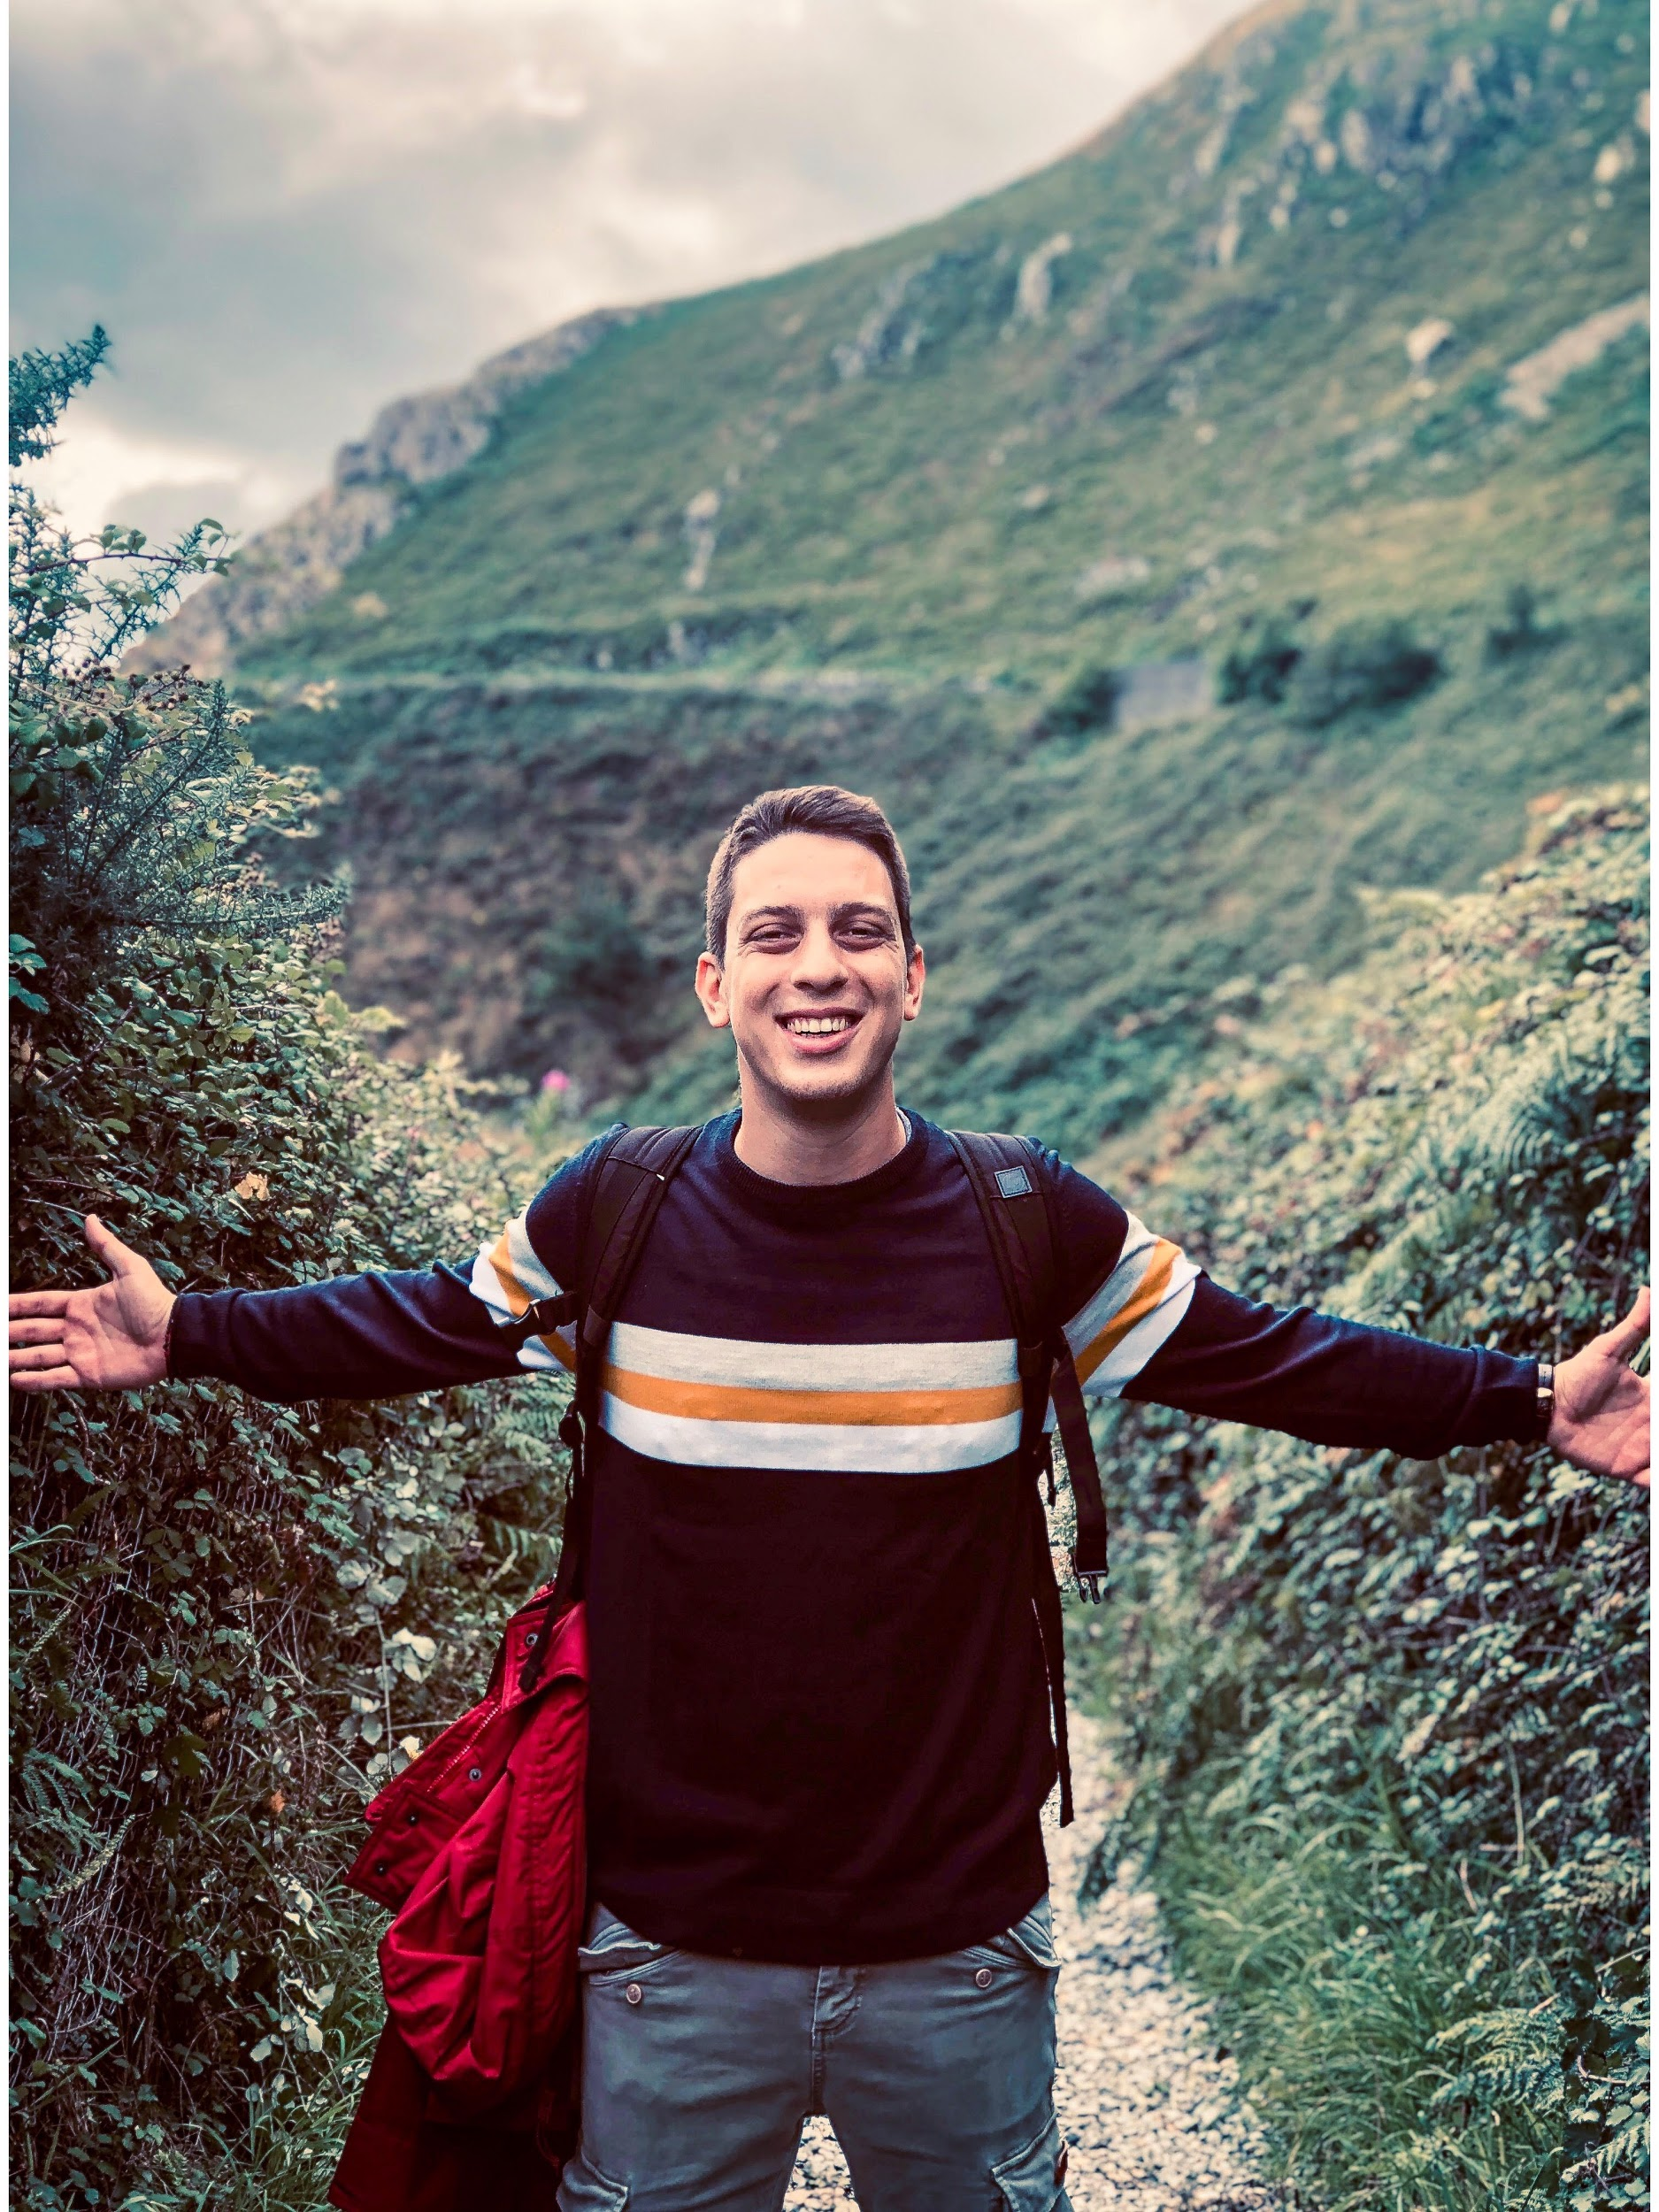
About the team
Synefakis Konstantinos
Computer Engineering and Informatics - University of Patras
Mantziaris Nikolaos
Business Administration -Athens University of Economics and Business

Slide 3


About the Idea
Estimations of 1,2 Billion Vehicles Worldwide
Not enough parking space in crowded cities
Not enough time to find a parking space

Slide 4




About the Idea
Parking Detection
Data icons (parking places)
Car and Parking detection
Happy People

Slide 5
When we faced the reality - Problems
Not enough knowledge
Not enough resources
Not enough data
Not enough time
Not the best results
Not the best algorithms

Slide 6

The dataset
Our dataset contains 150x150 images of
<CAMERA> can be A or B
<CLASS> can be free or busy
YYYYMMDD_HHMM is the zero-padded 24-hour capture datetime
<SLOT_ID> is a local ID given to the slot for that particular camera

Slide 7
The dataset
Extra files - FULL_IMAGE 1000x750
<WEATHER> can be SUNNY, OVERCAST or RAINY
<CAPTURE_DATE> is the zero-padded YYYY-MM-DD formatted capture date
<CAM_ID> is the number of the camera, ranging 1-9
<CAPTURE_TIME> is the zero-padded 24-hour HHMM formatted capture time

Slide 8
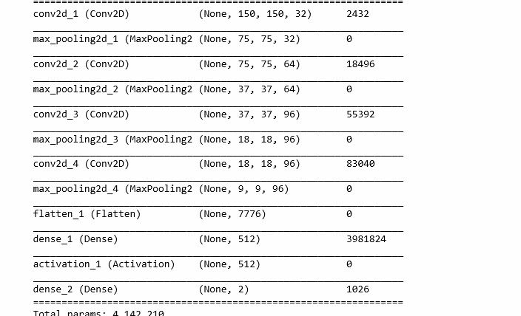
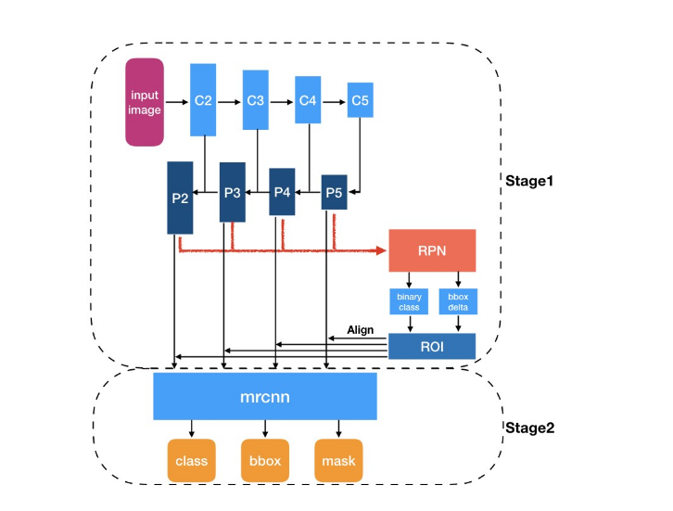
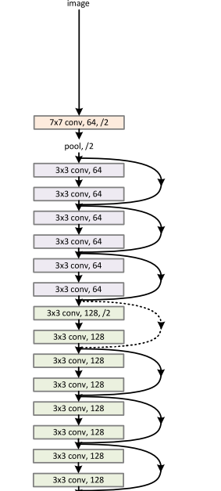
Methodology - Models Used
CNN
R-CNN
ResNet 50

Slide 9
Methodology - CNN model
ReLu
Activation
Softmax
Last dense layer - Activation
Adam Optimizer
Lr = 0.001 categorical cross - entropy as loss - accuracy metric

Slide 10
Methodology - R.CNN model
First Stage
Second Stage
Neural Net. RPN scans all FPN top-bottom pathways and propose regions which may contain objects
Neural Network takes proposed regions by stage 1 and assign to several specific areas of a feature map
Anchors is a method bund features to its raw image location
It scans these areas and generates object classes, bounding boxes and masks
Ground-truth classes and bounding boxes are assigned to individual anchors according to IoU value
Without anchors, it uses ROI Align to locate the relevant areas of feature map
RPN figure out where of the feature map get an object and what size the bounding box is.

Slide 11
Methodology - ResNet 50
Instead of trying to learn some features it learn from residuals
Residuals are a subtraction of features learned from input of the layer.
ResNet 50 uses shortcut connection - Directly connects nth layer to (n+x)th layer
Easier from training deep convolutional neural networks and degrading is resolved.

Slide 12
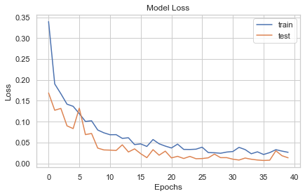
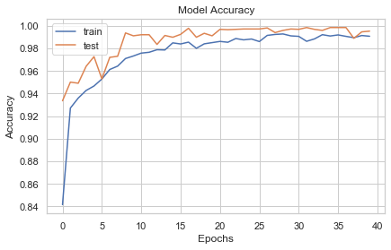
Results

Slide 13
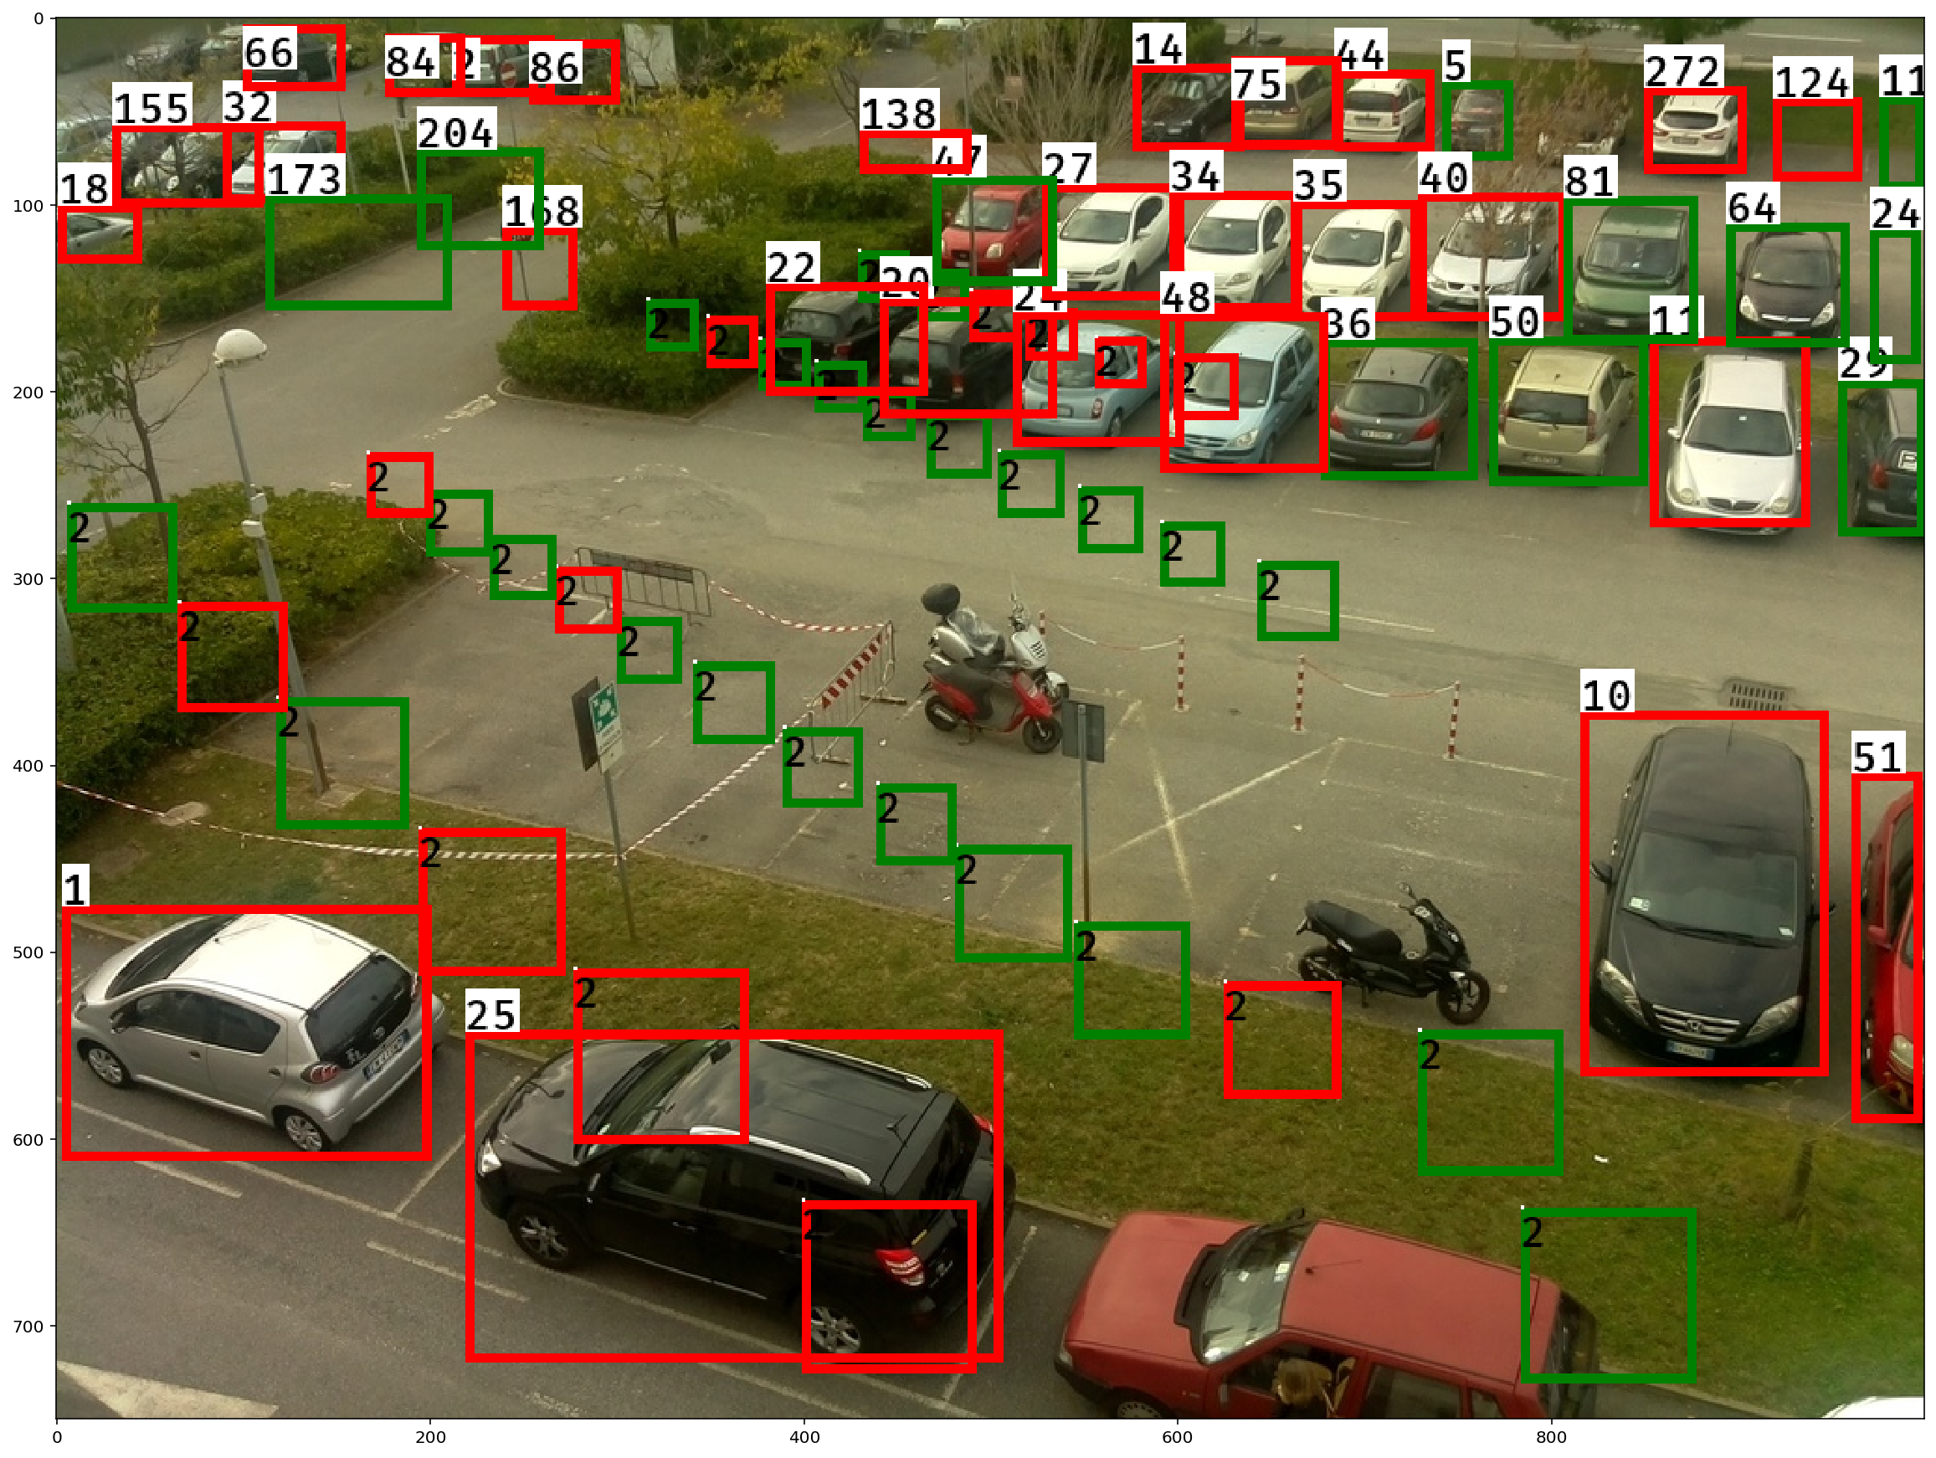
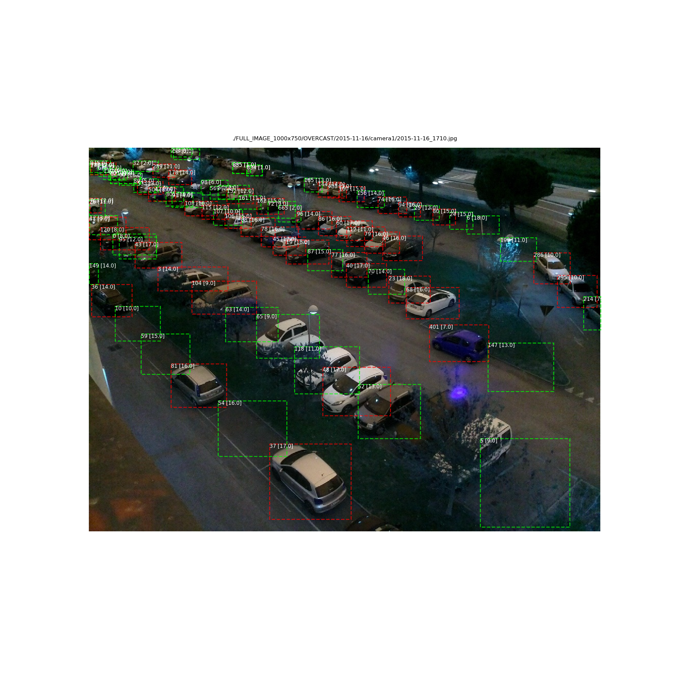
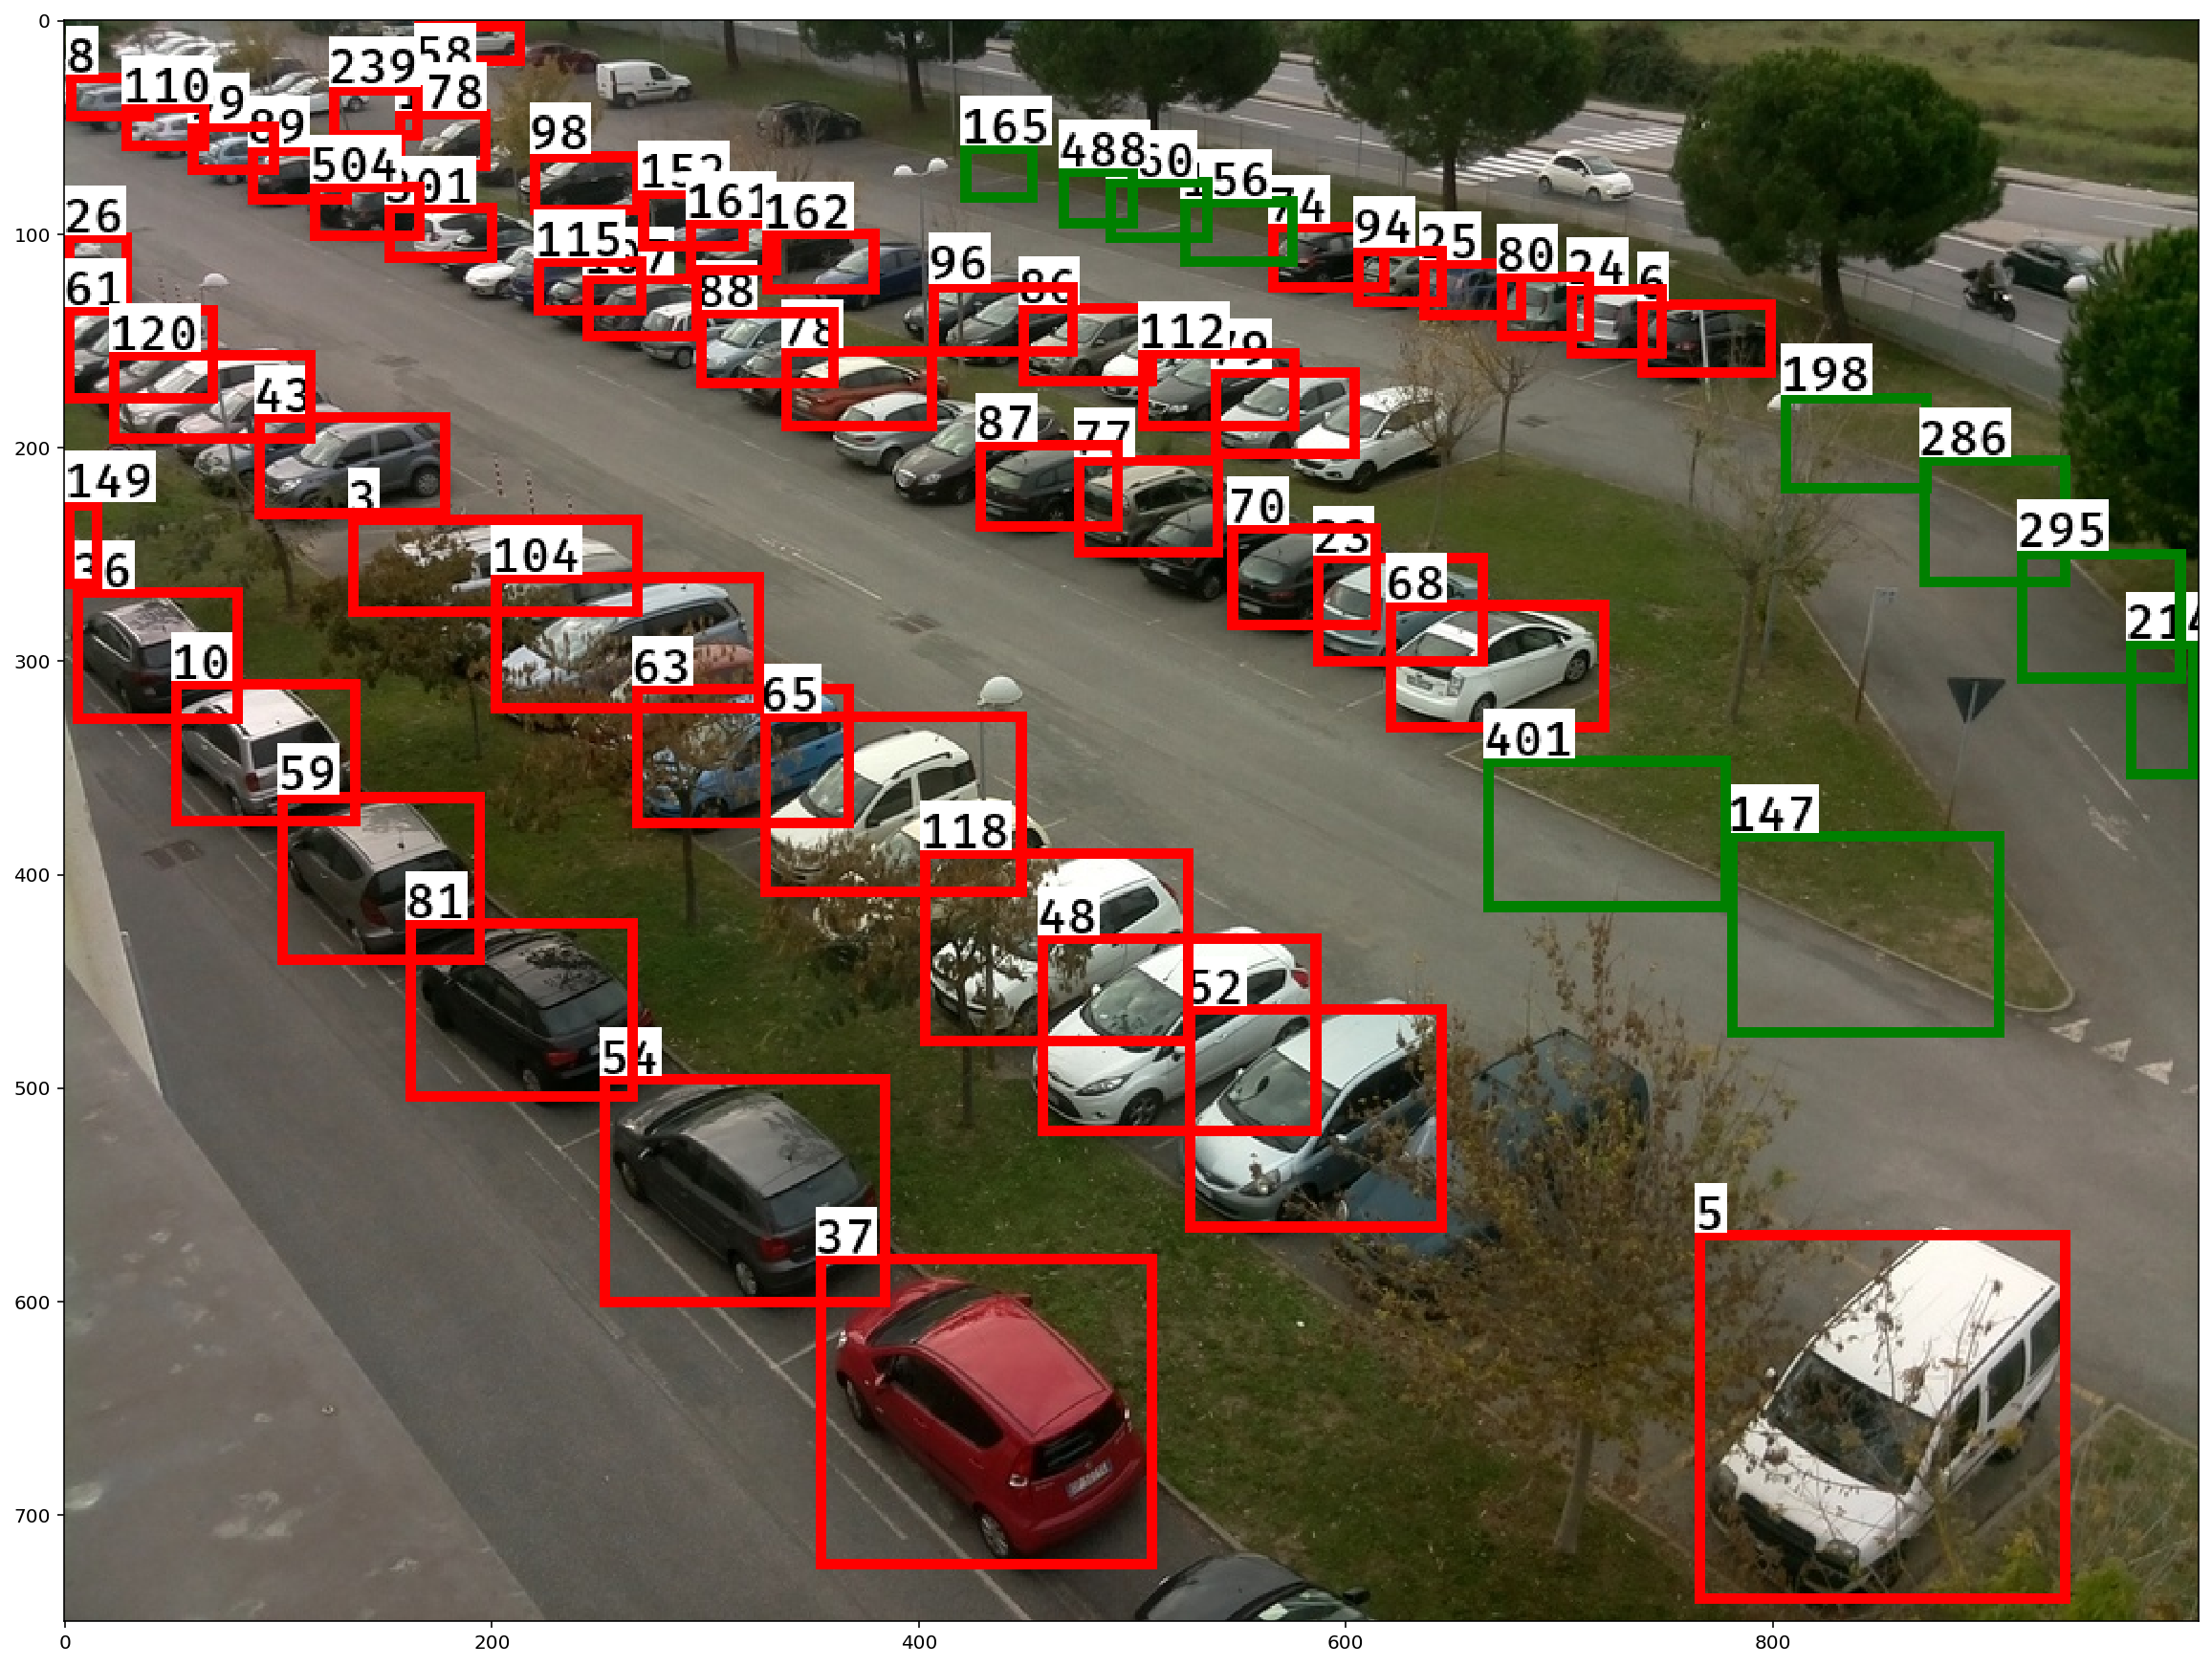
Results

Slide 14
Thank You

